Slide 1
Great Theorem: Quadrature of the Lune
Hippocrates
Journey Through Genius Pp 17
Notes:
**include the theorem from the epilogue, the circle in not quadrable**

Slide 2
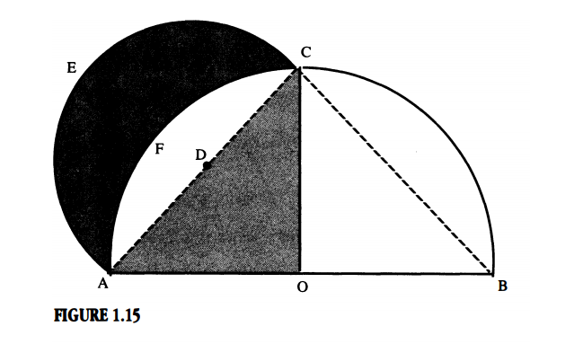
Quadrature of the Lune
A lune: simply put, is a crescent
Hippocrates’ result rested on three preliminaries: the pythagorean theorem, an angle inscribed in a semi-circle is a right angle, the area of two circles (or semi-circles) are to each other as the squares on their diameters *
The lune he squared was a specific type of lune **
Notes:
*explain this notion
***explain construction as in course notes

Slide 3
We will now examine the great proof.

Slide 4
Discussion:
Trace through the (fallacious) argument attributed to Hippocrates to the effect that the quadrature of the lune implies the quadrature of the circle (Journey Through Genius, pp. 20- 22). Be sure you can identify where the error occurs. Does anyone seriously believe this would have deceived the great Hippocrates?

Slide 5
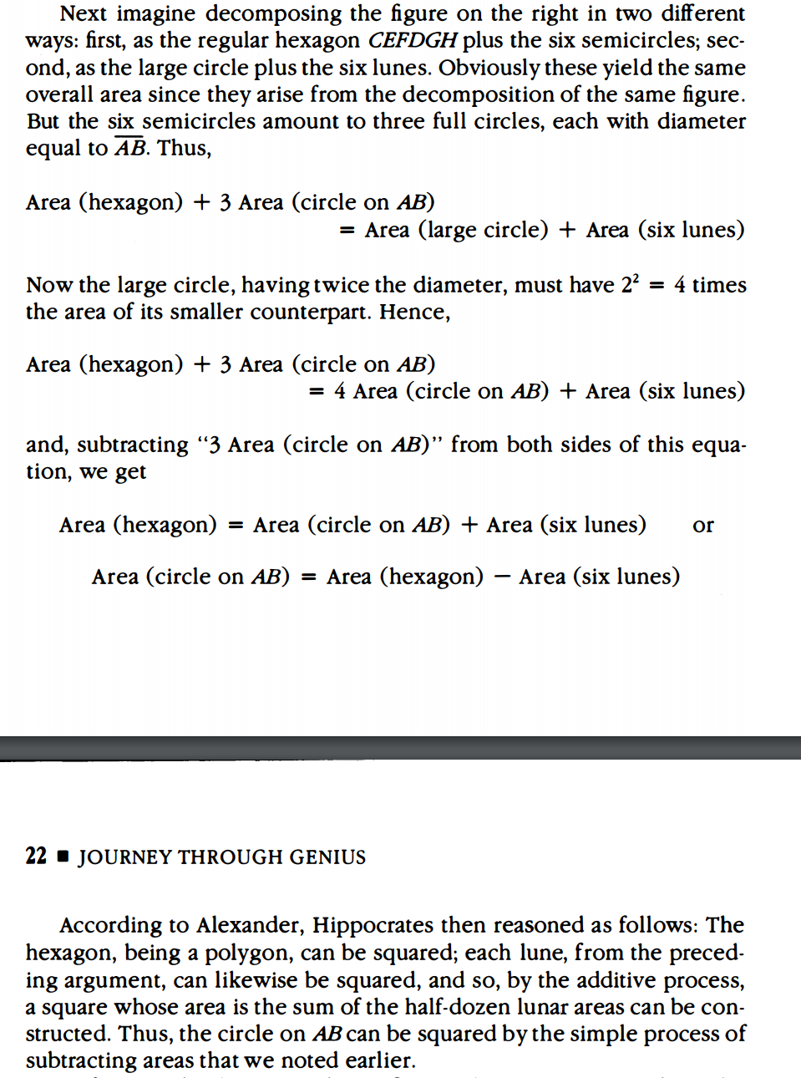
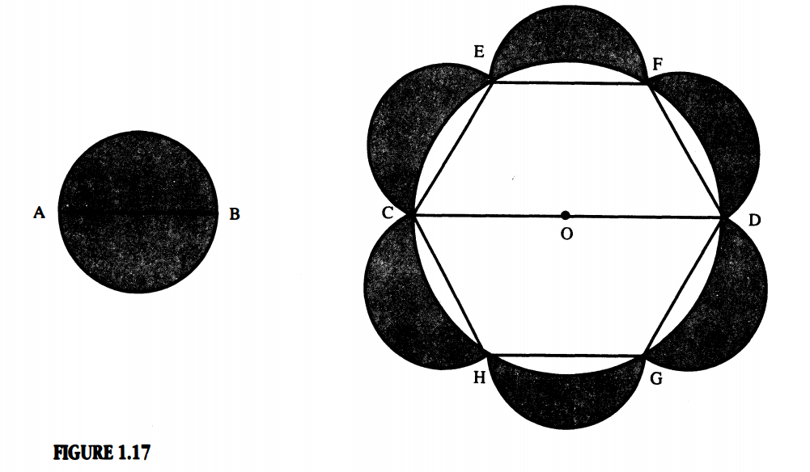

Slide 6
Where was his fault?

Slide 7
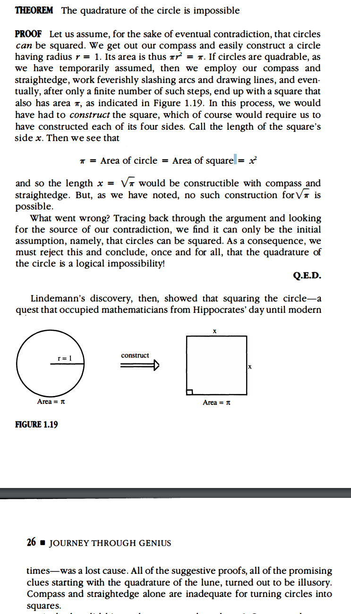
We now know the quadrature of a circle is impossible.

